Slide 1
Veloce used in Sirius
Jianzhong Zhang

Slide 2
Content
Introduction
Veloce Flow
Veloce used in Sirius Verification
Debug Tips

Slide 3
Introduction about Veloce Emulator
Why do we choose Veloce Emulator?
Traditional EDA software simulation is too slow for large SOC.
FPGA signal visibility is poor.
Veloce Emulator is 1000 times faster than EDA simulation and all signal visible.It helps us to verify our chip conveniently and quickly.

Slide 4
Introduction about Veloce Emulator
Feture of Veloce Emulator
High-capacity and high-speed
100% signal visibility and strong ability of debug
Compile quickly
Multiple user and multiple modes

Slide 5
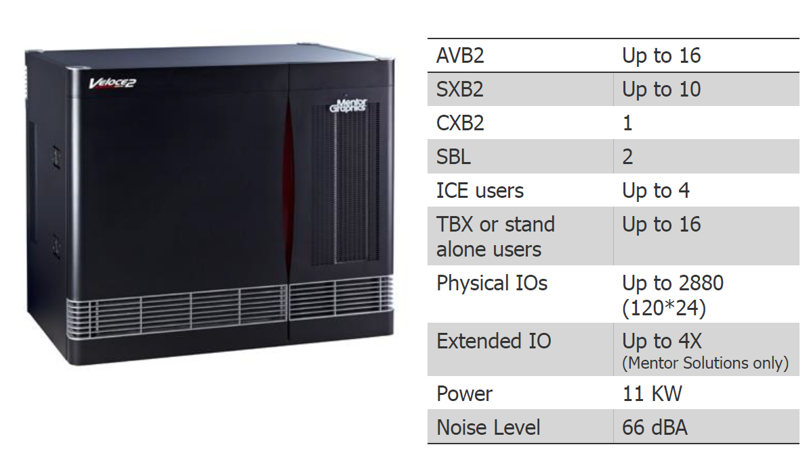
Introduction about Veloce Emulator
Veloce2 Quattro

Slide 6
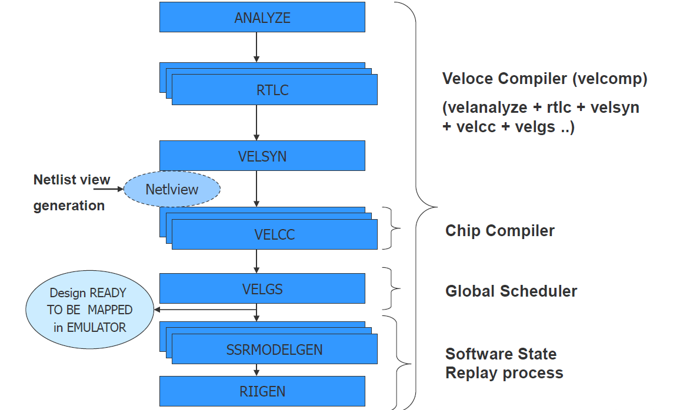
Veloce Flow
Library unit mapping
Clk/memroy
Compilation
Analyzer
Rtlc
Velsyn
Velcc
Velgs
Ssrcc
Simulation
Make build
Make sim
Debugging

Slide 7
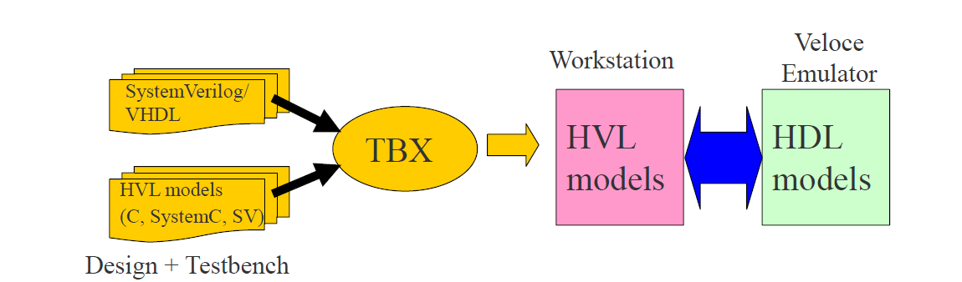
Veloce Flow
What is TBX(TestBench eXpress)
An environment/infrastructure where
—the design runs on a hardware platform (Veloce)
—the testbench (C or SystemCor SV) runs on a software platform (workstation)
—the two communicate through a transaction interface
A transaction-based co-modeling environment
—as opposed to a pin/cycle-based co-simulation environment
Uses SystemVerilog-DPI (SV-DPI) for transaction-based data transfer across workstation and hardware

Slide 8
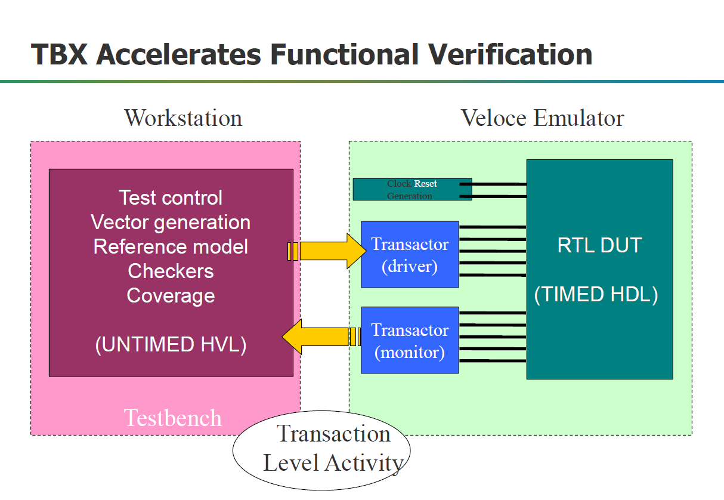
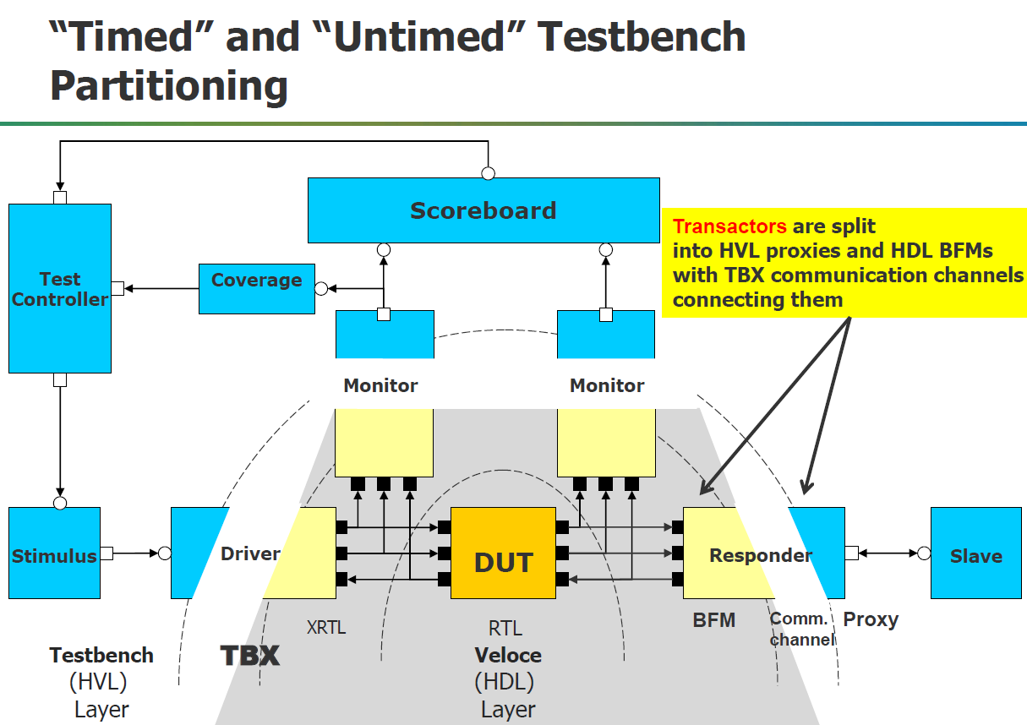
Veloce Flow

Slide 9
Veloce Flow
Make build
Velhvl:add the source language of HVL in veloce.config
-comp –hvl [c|systemc|questa]
There are two ways to compile the HVL
-velcomp –task hvl
-velhvl
It is the command for all the hvlcompilations
-velhvl–cfiles <user C/C++ files>
Same command for all type of hvlsource language except Questa

Slide 10
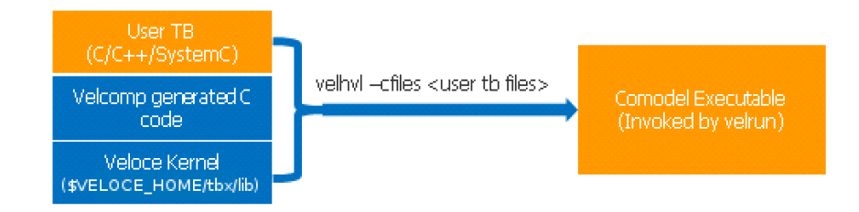
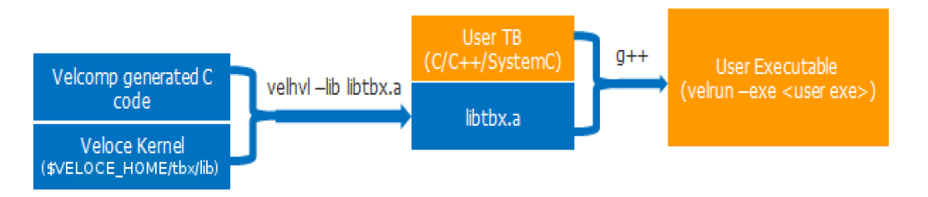
Veloce Flow
Automated C Compilation
Manual C Compilation

Slide 11
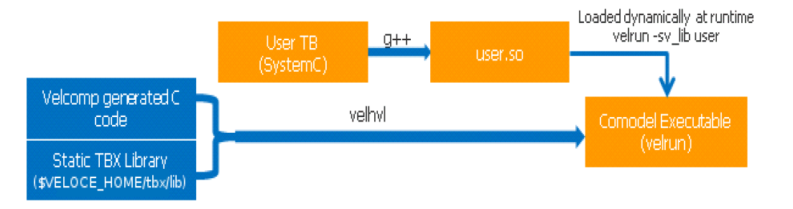
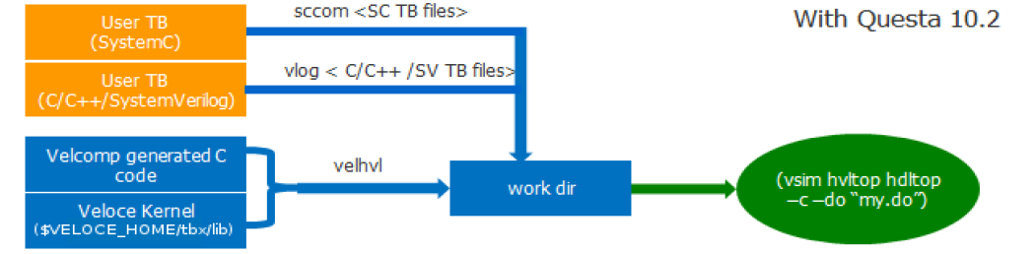
Veloce Flow
Compiling for Dynamic loading
Questa Mode HVL Compilation

Slide 12
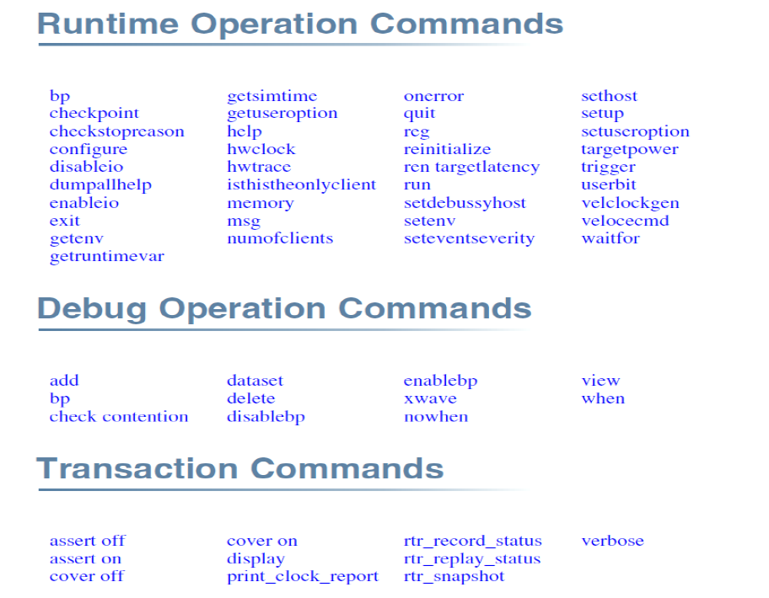
Veloce Flow
Make sim
All use modes use velrun
-velrun
-velrun –c
-velrun –gui
Vsim used for Questa test-benches
Velrun:Platform TCL commands

Slide 13
Veloce used in Sirius Verification
For Artosyn project Sirius, Veloce Emulation flow is to run real use case for verification. To use Veloce resources efficiently, we deliver Veloce images in 4 different types, targeting different scenarioes.
From Build 1 to Build 4 the included designs become more and more. One of the target is to keep image small enough for Veloce limited AVBs and concurrent usage.
Build 1: Minimal System
Build 2: A7 plus CEVA
Build 3: Video Case
Build 4: Wireless Tx/Rx

Slide 14
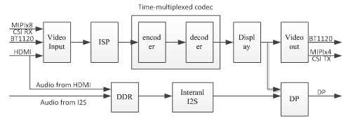
Veloce used in Sirius Verification
Example(build3)

Slide 15
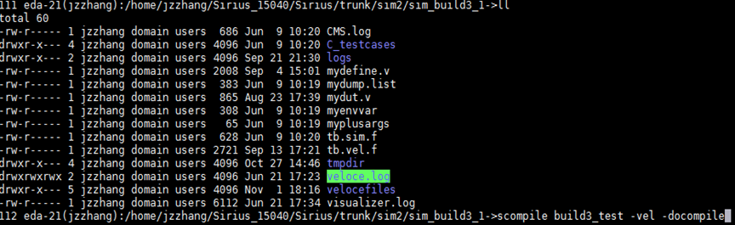
Debug Tips
scompile test_case –vel –docompile
cd to tmpdir/test_case_VEL
make build
make sim

Slide 16
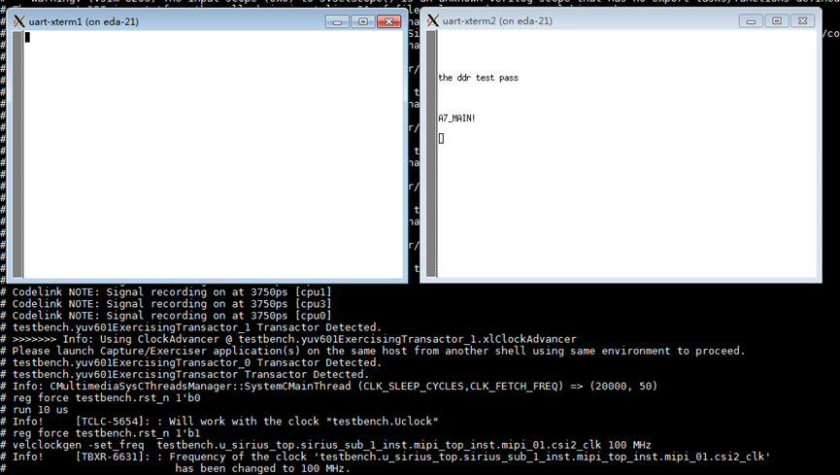
Debug Tips
Run.do/run.tcl
memory upload/download
trigger download
reg force value
xwave on
UART

Slide 17
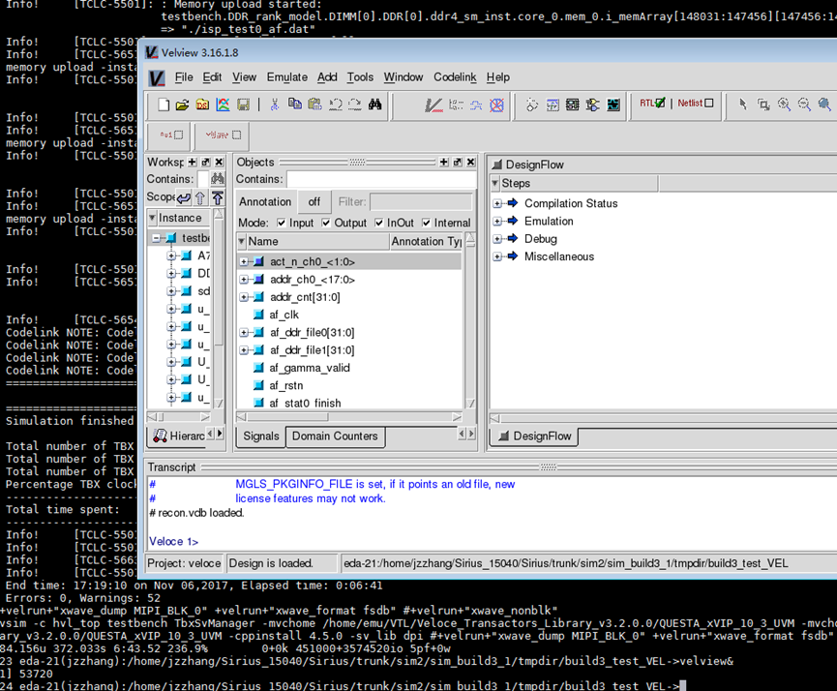
Debug Tips
Wave
Velview

Slide 18
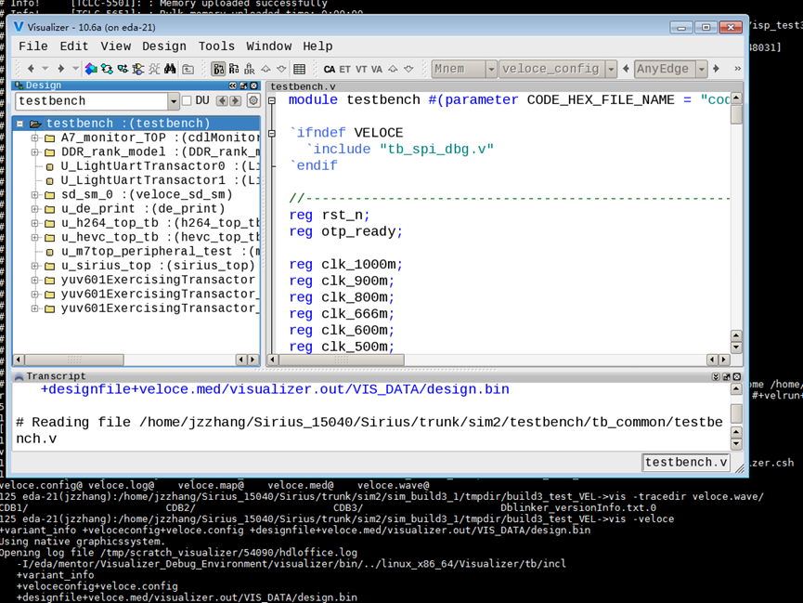
Debug Tips
Wave
Visualizer

Slide 19
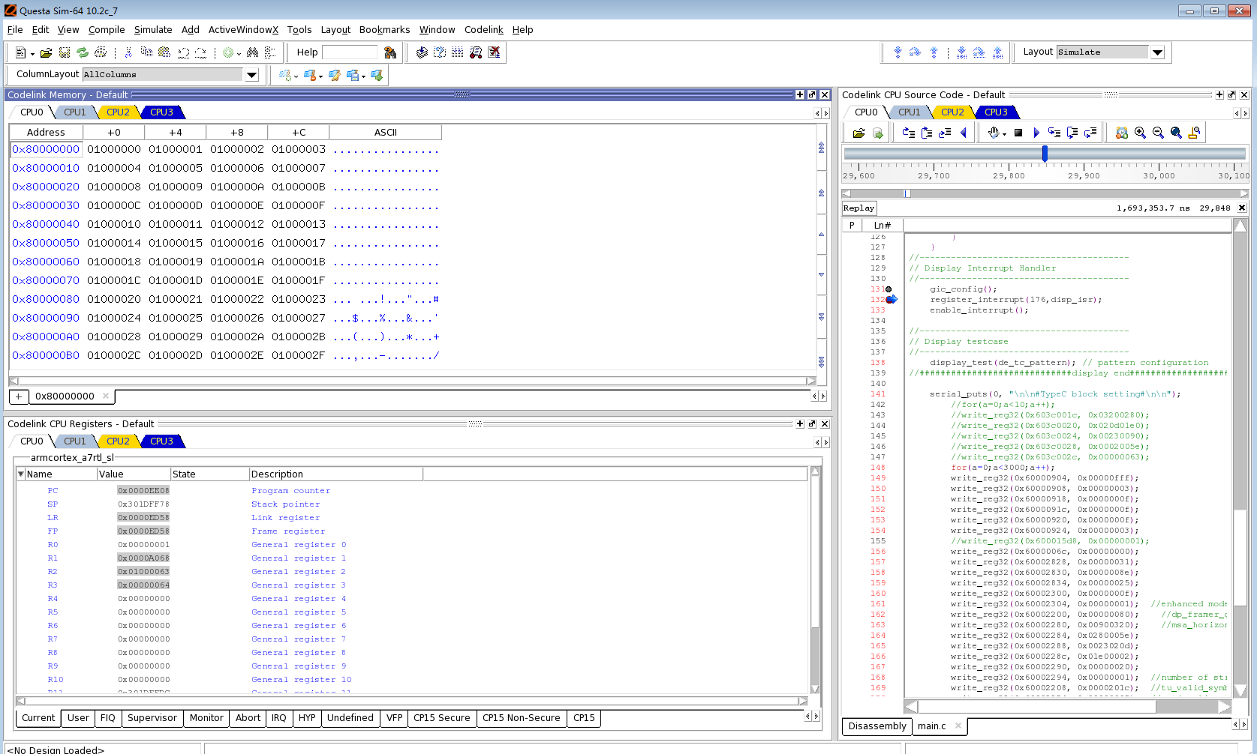
Debug Tips
Codelink
Software running state,break point,one step,one function
Memory value(DDR)
Register value

Slide 20
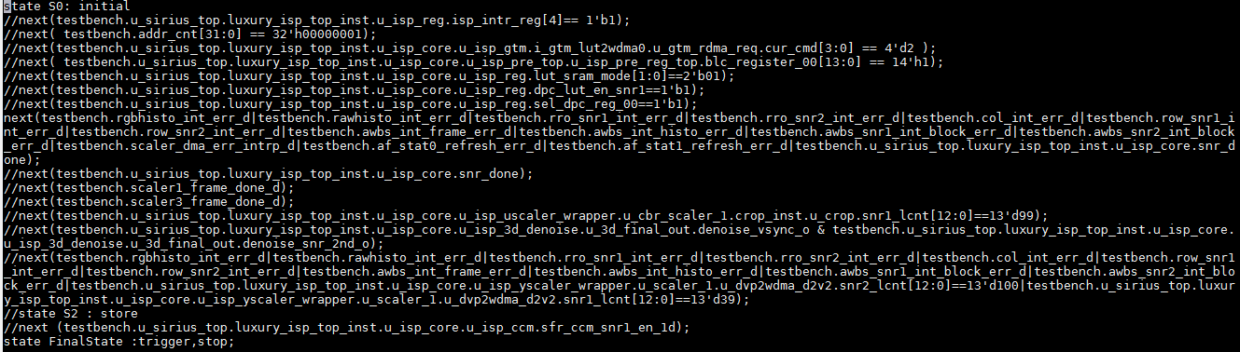
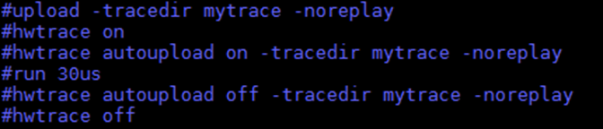
Debug Tips
Trigger file + HWtrace

Slide 21
Q&A
Thanks. Q&A

